Slide 1

Database Systems
Project
Barak Moskovich
Denis Karabitski

Slide 2
Introduction
Zoom as a videotelephony software in earlier days
Challenges
COVID-19 pandemic made the whole world change its lifestyle for the worst and for the best
Evolution
Zoom was forced to evolve at a fast pace

Slide 3
User Types
Admin – Fill daily reports about meetings and clients.
Client – Update his personal data, send private and public messages in a meeting, can create meetings and can see whenever some of his contacts is in a meeting.
In a meeting:
Host - Remove and add user to a meeting.
Co-Host - Add user to a meeting.
Viewer - Participate in a meeting (default).
Client subscription type:
Free - 1h time limit in a meeting.
Paid - Unlimited.

Slide 4
Data
Client - Participates in a meeting or not, and stores client data.
Subscription - Each client has 1 subscription that can be changed.
Meeting - There are maximum participants that allowed to join a meeting and each one has its one role and permission.
Channel - Group of clients that can communicate with each other and a channel can be private or public.
Messages – Store all messages that was sent by each client

Slide 5
The Entities
Country (country_id, country)
City (city_id, country_id, city)
Address (address_id, city_id, address, address2, district, postal_code, last_update)
User_type (user_type_id, user_type)
Client (client_id, address_id, user_type_id, first_name, last_name, email, status, password, last_update)
Contacts (client1_id, client2_id)
Exposure (exposure_id, exposure)
Channels (channel_id, exposure_id, name, last_update)
Channels_members (channel_id, client_id, last_update)
Meeting (meeting_id, title, date, time_limit, last_update)
Messages (message_id, sender_client_id, reciver_client_id, message, last_update)
Permissions (permission_id, permission)
Participants (client_id, meeting_id, permission_id, last_update)

Slide 6
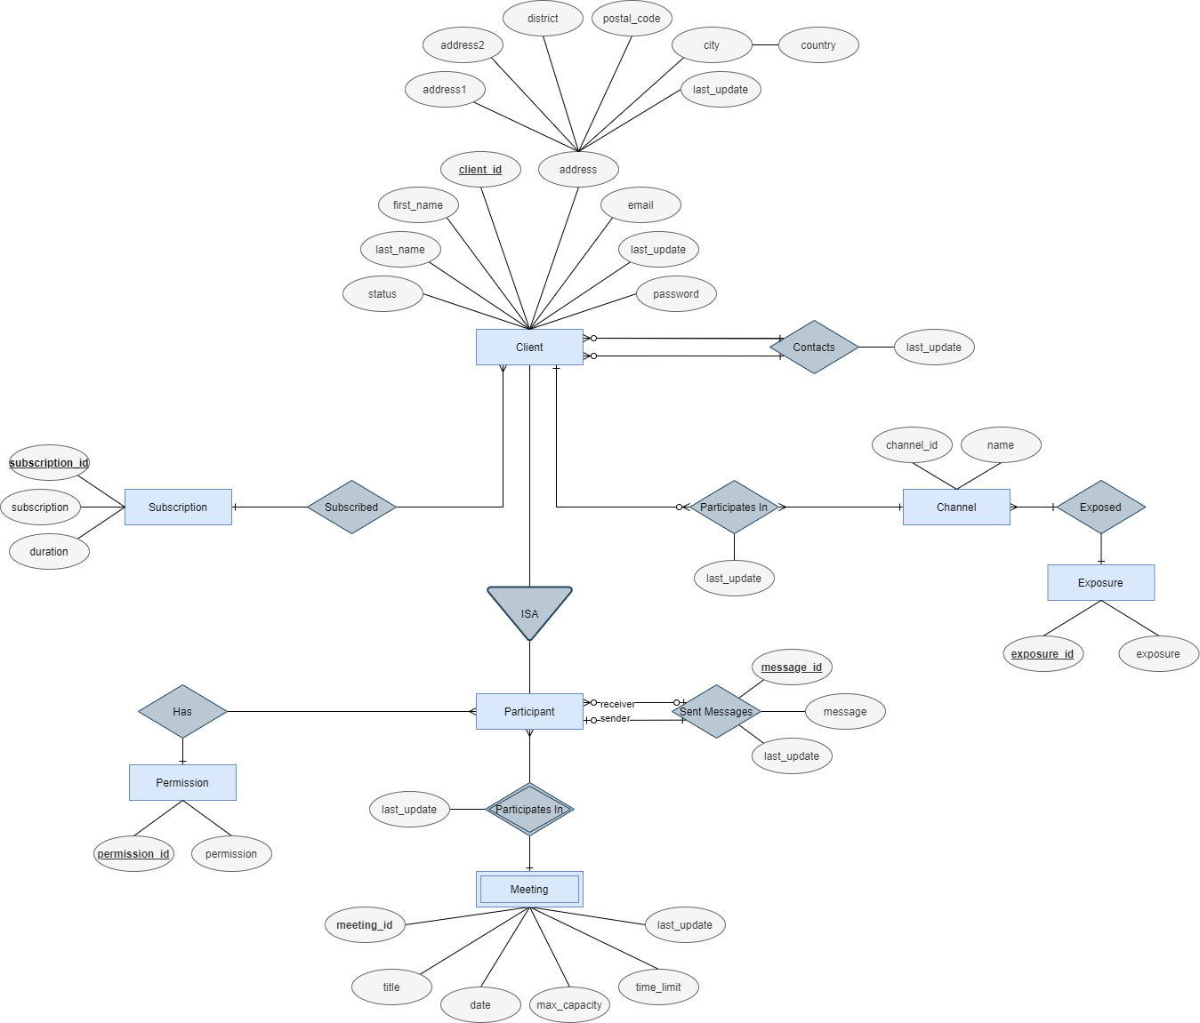
Database ERD

Slide 7
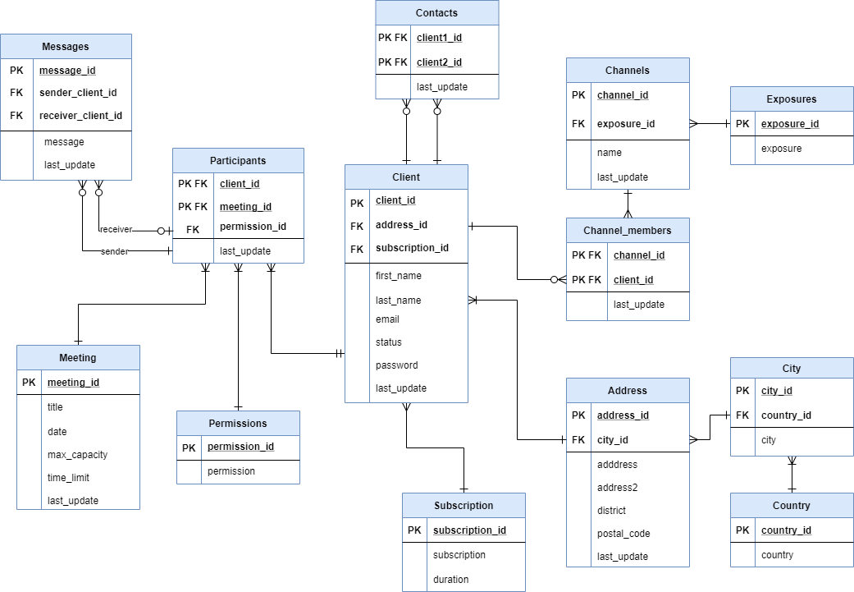
Database Tables

Slide 8
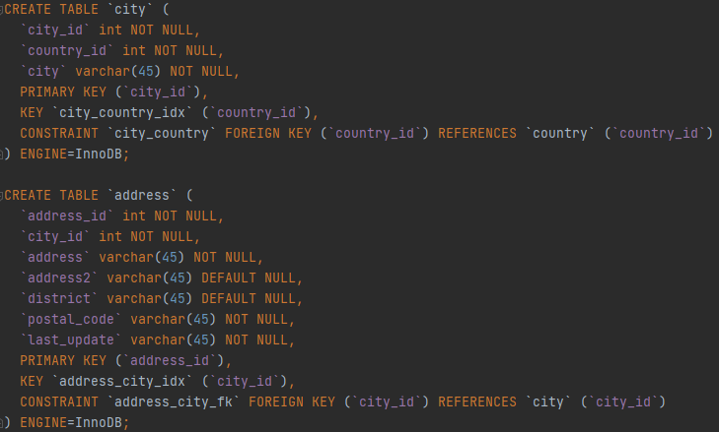
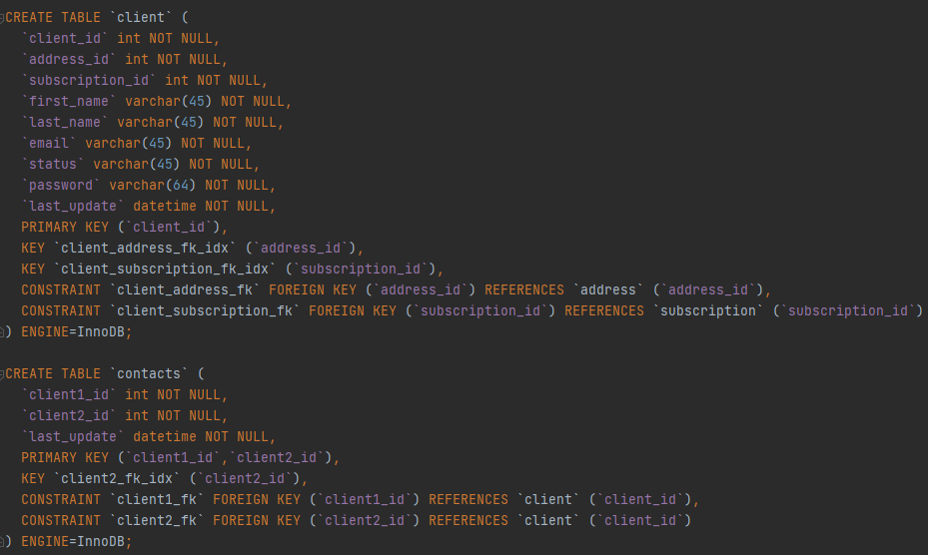
Sample Creating Tables

Slide 9
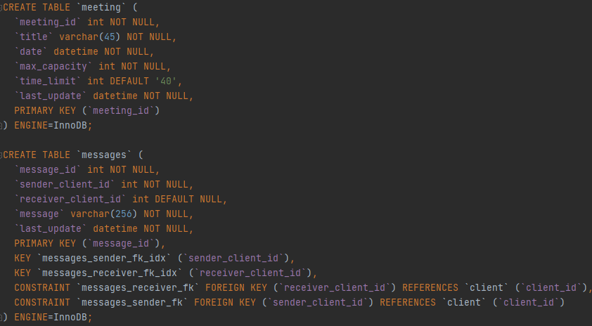
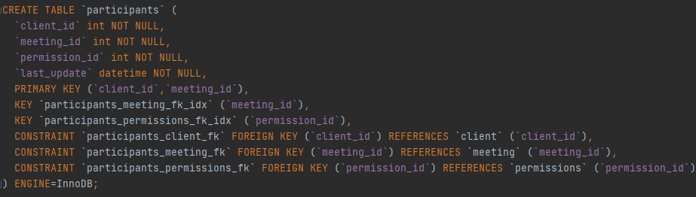

Slide 10
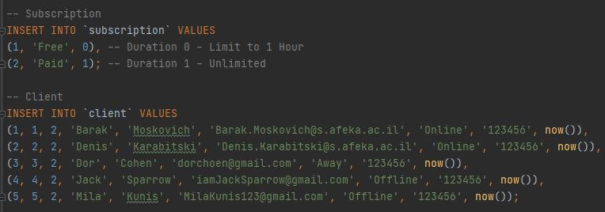
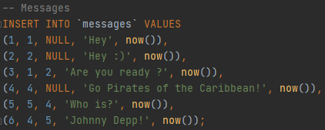
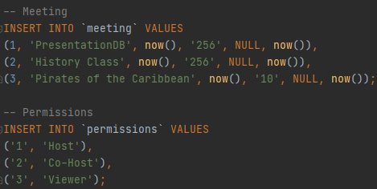

Sample Insertion Data

Slide 11
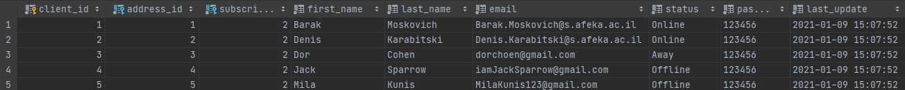
Sample Client Table

Slide 12
Select Queries
List all friend names for a specific client.
Show all friends that live in Israel.
Show all channels for a specific user.
Show all participants in a single meeting.
Show how many meetings are there that have more than 10 participants in it. (Admin)
List all mutual Channels for 2 participants in the same meeting. (Admin)
Show meetings name and number of participants that have at least 2 people in it. (Admin)
Show the longest meeting that is currently running. (Admin)
Show meeting name for all contact from a specific user friend list.
Show all public Channels.
Show all users that are from United States.
Show all mutual friends between two users.
Show all mutual Channels between two users.

Slide 13
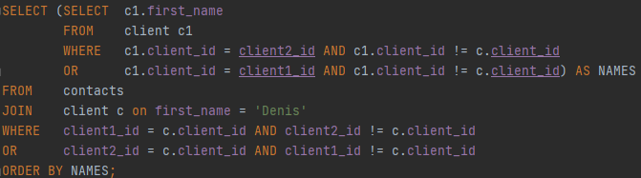
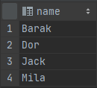
Sample Select Query
List all contacts names for a specific client (by name)
Results

Slide 14
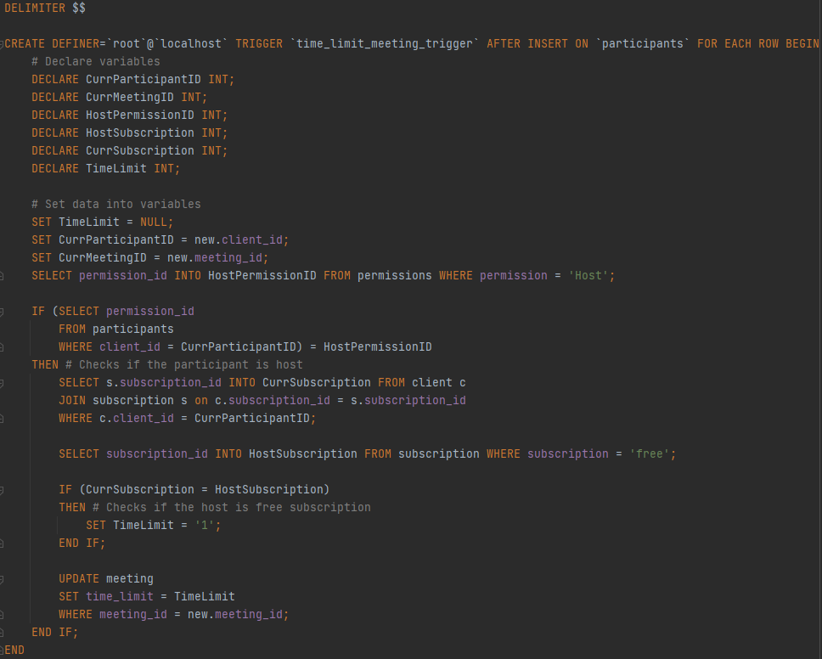
Triggers
“FREE” users can open a meeting for only 1 hour.
“PAID” users have an unlimited time for a meeting.

Slide 15
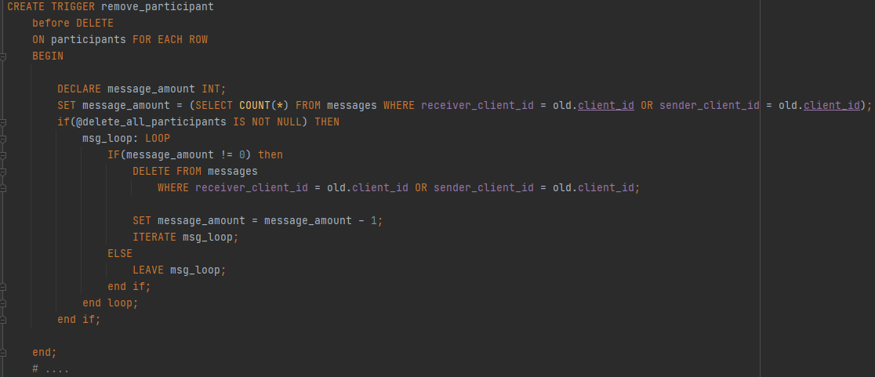
Triggers
When “HOST” leaves a meeting, “kick” all participants and close the meeting.

Slide 16
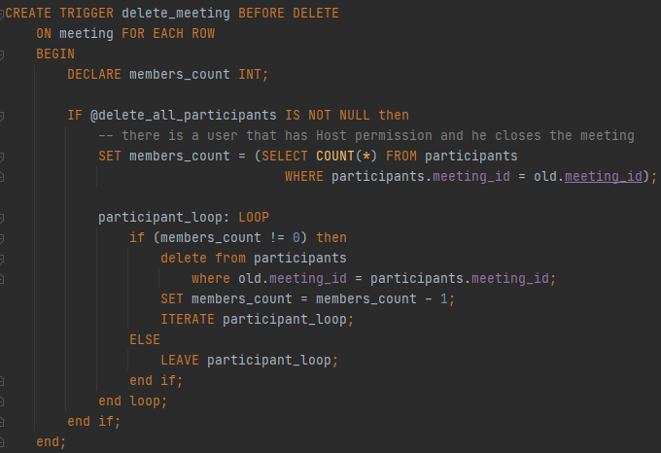
Triggers

Slide 17
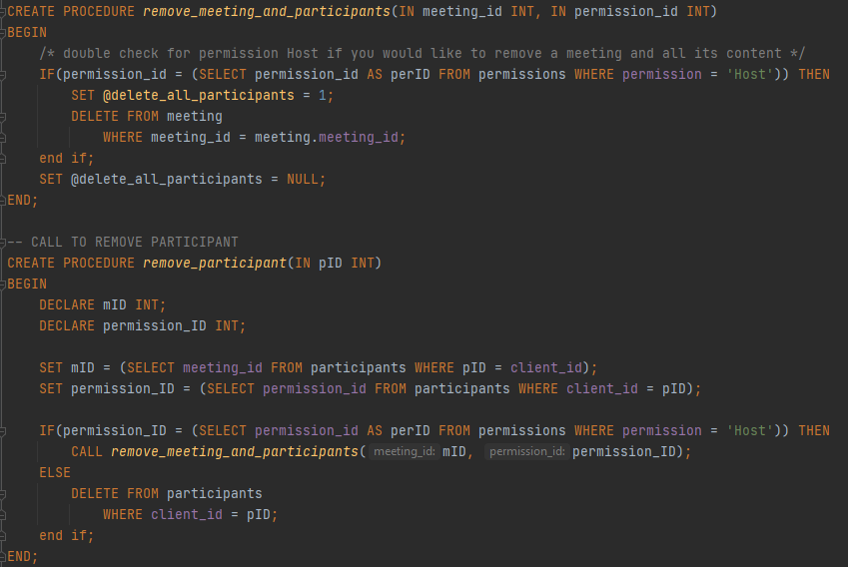
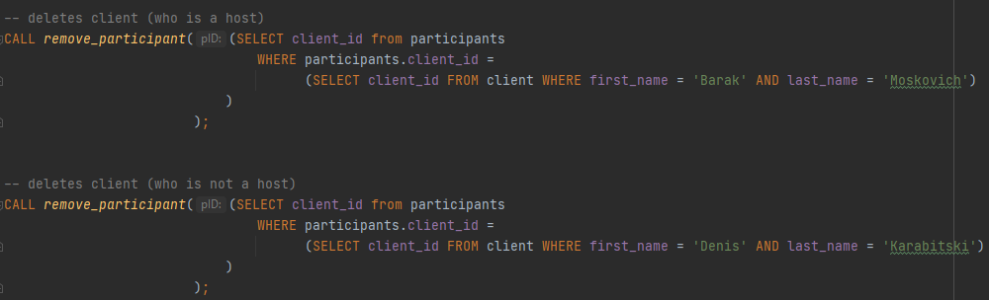
Triggers

Slide 18
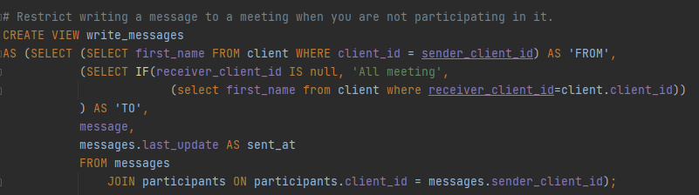
Database Security
Restrict writing a message to a meeting when you are not participating in it.

